Slide 1


Enhancing Customer Lifetime Value Predictions with Advanced Machine Learning and Deep Learning Models
Shashwat Dhayade

Slide 2
Objective
Expected Outcome
Enhance the accuracy and efficiency of Customer Lifetime Value (CLTV) prediction by:
Leveraging advanced machine learning and deep learning techniques.
Improving the current RandomForestRegressor model with optimized feature engineering and additional algorithms.
Experimenting with neural network architectures to capture complex patterns and dependencies in the data.
Significantly improve accuracy and efficiency of CLTV prediction.
Provide businesses with more reliable tools for decision-making and customer management.

Slide 3
Limitations of Traditional CLTV Methods
Traditional models like Recency-Frequency-Monetary (RFM) and Pareto/NBD struggle with modern consumer behavior complexities.
Two-stage models (churn prediction + revenue estimation) oversimplify the churn-revenue relationship (Weng et al., 2024).
RFM oversimplifies dynamics, missing broader purchasing patterns (Vanderveld et al., 2016).

Slide 4
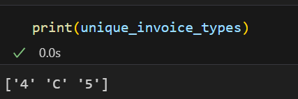
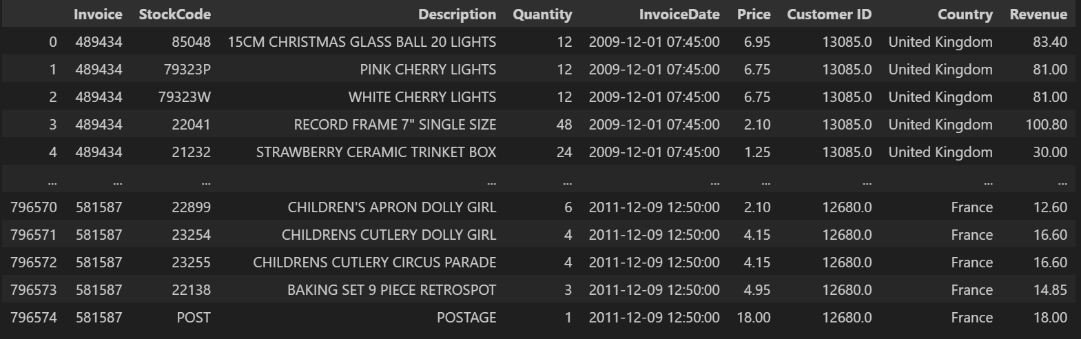
Data Understanding
Invoice: Refunds have different Invoice Number. It depends on date and time.
Quantity: It contains negative values for refunds
InvoiceDate: Contains time of purchase.
Price: Price of each quantity. All of them are positive.
Customer ID: All of them are positive. Unique to each customer.
6. Country: 43 countries. Majority Purchase from UK (981330)

Slide 5
7. Description: 5296 Unique
Test Product: 16 (Removed)
Negative Quantity: 4
Adjustment by john/peter: 55 (Removed)
Assumption: They represent some instances that might balance out the data
Next Day Carriage: 80 (Removed)
Assumption: They represent immediate delivery fees
POSTAGE: 1983 (Remove)
DOTCOM POSTAGE: 16 (Removed)
Assumption: They represent the delivery fees
Discount: 170
Manual: 1066 (Removed)
Assumption: They represent labor work involved in the purchase
Bank Charge: 35 (Remove?)
Assumption: They represent the charge on the purchase by the bank
CRUK (Cancer Research UK) Commission: 16 (Removed)
Assumption: They represent some fees paid
Only one customer has this history: 14096

Slide 6
Data Understanding
8. StockCode: 4643 Unique
TEST001/002: Test Products
D – Discount
M – Manual
POST – Postage
PADS – Cushion Products
ADJUST – Adjustment by john/peter
DOT – DOTCOM POSTAGE
CRUK – CRUK Commission
BANK CHARGES
SP1002 – Kid’s Chalkboard
SrockCodes having letters (e.g. 12344P): Specific product labeling
12. C2 (Carriage): 254 (Removed)
Assumption: Delivery Charges ($50)

Slide 7
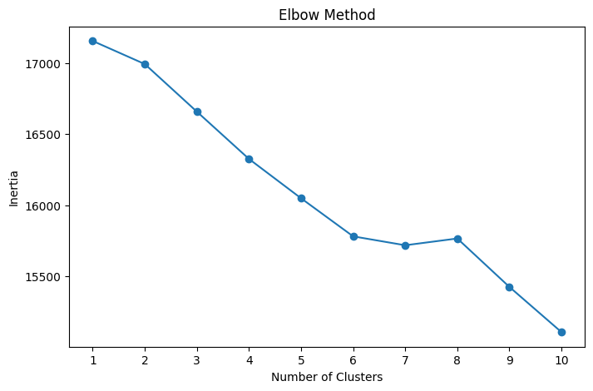
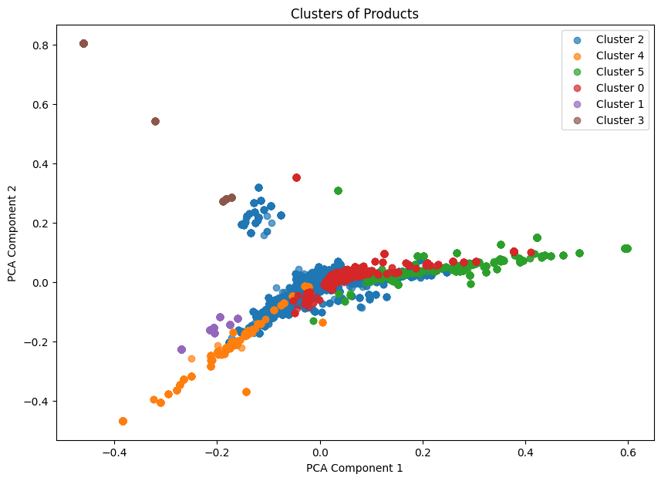
Product Description Analysis for Refunds (Charge Back fraud Charge)
Cluster 0 – Kitchen
Cluster 1 – Lights
Cluster 2 - Potting/Glass/Paper
Cluster 3 - Regency Cakestand
Cluster 4- Hanging
Cluster 5 - Red and Spotty

Slide 8
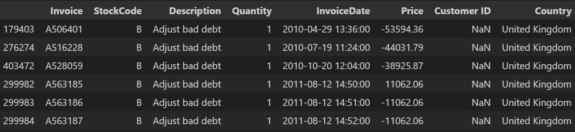
Data Cleaning
Removed Customers with no positive purchase history: 128
Duplicate Data: 34335
Overlap in Data for 2010-12
Missing Values

Slide 9
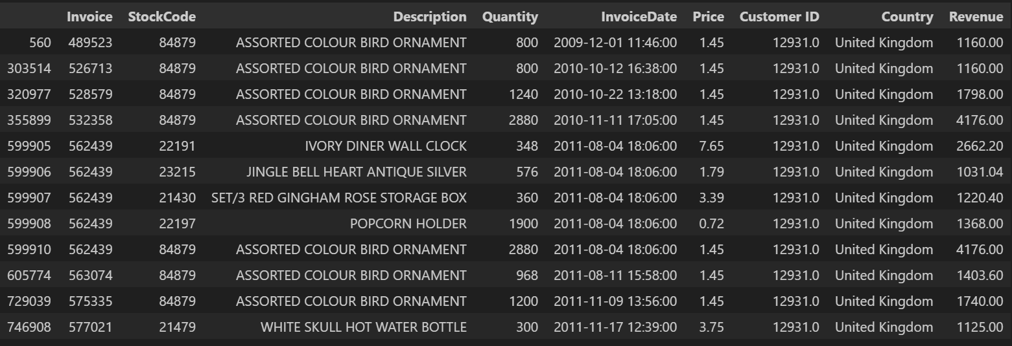
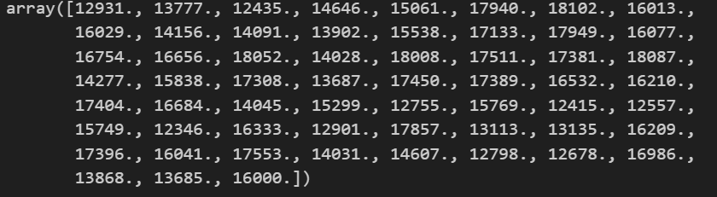
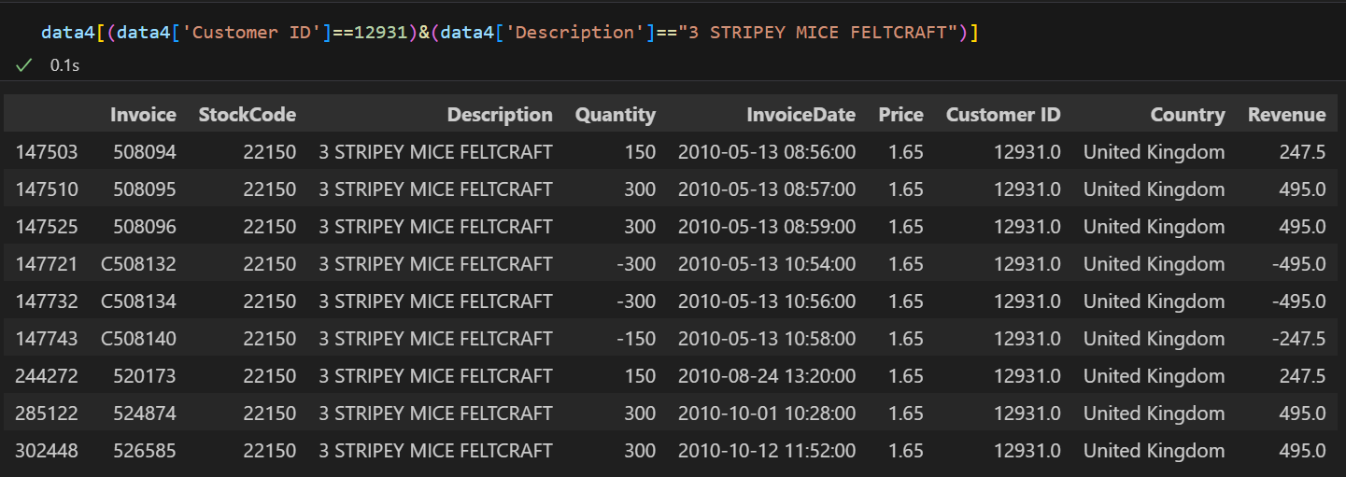
Extreme / Unusual Data
Without Feature Extraction

Slide 10
Feature Engineering
Split positive and negative data
'Frequency_Weekdays_Refunds',
'Monetary_Weekdays_Refunds',
'Quantity_Weekdays_Refunds',
'Frequency_Weekends_Refunds',
'Monetary_Weekends_Refunds',
'Quantity_Weekends_Refunds',
'Refund_Recency',
'Refund_Monetary_Mean',
'Refund_Monetary_Sum',
'Refund_Monetary_Min',
'Refund_Monetary_Max',
'Refund_Unique_Items',
'Total_Price_Sum',
'Total_Quantity',
'Unique_Countries',
'Quantity_First_Two_Weeks',
'Quantity_Last_Two_Weeks',
'Quantity_Weekdays',
'Refund_Unitprice_Mean',
'refund_unitprice_min',
'refund_unitprice_max',
'refund_unitprice_var',
'refund_total_price_sum',
'refund_total_quantity',
'Discount_Frequency',
'Discount_Monetary_Value',
'Discount_Ratio',
'Discount_Revenue_Ratio',
'Discount_Quantity_Value'
'Quantity_Weekends',
'Refund_Frequency',
'Refund_to_Purchase_Ratio',
'Frequency_First_Two_Weeks_Refunds',
'Monetary_First_Two_Weeks_Refunds',
'Quantity_First_Two_Weeks_Refunds',
'Frequency_Last_Two_Weeks_Refunds',
'Monetary_Last_Two_Weeks_Refunds',
'Quantity_Last_Two_Weeks_Refunds',

Slide 11
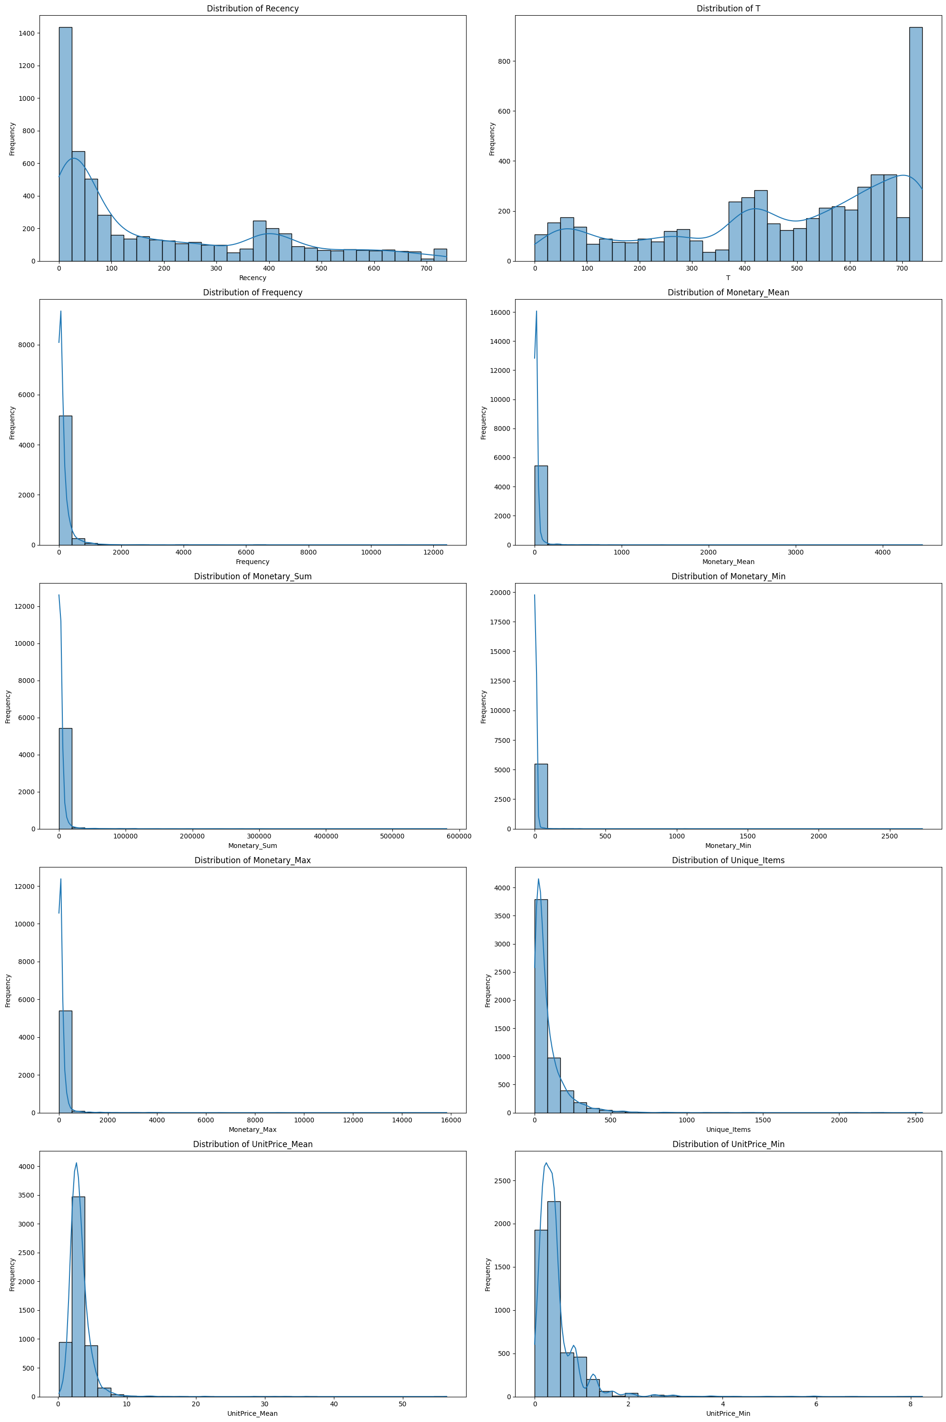
Distribution of Features

Slide 12
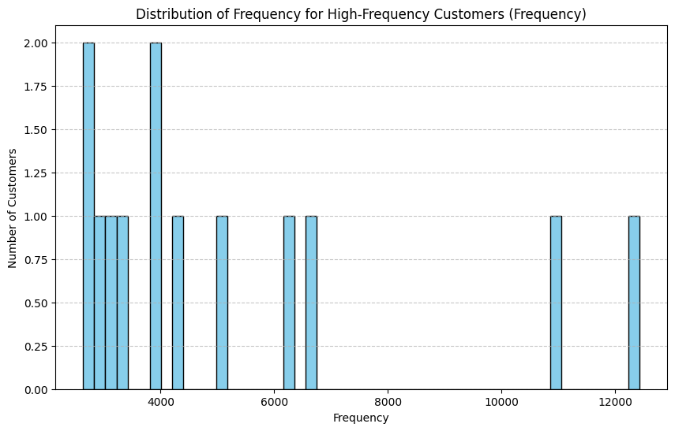
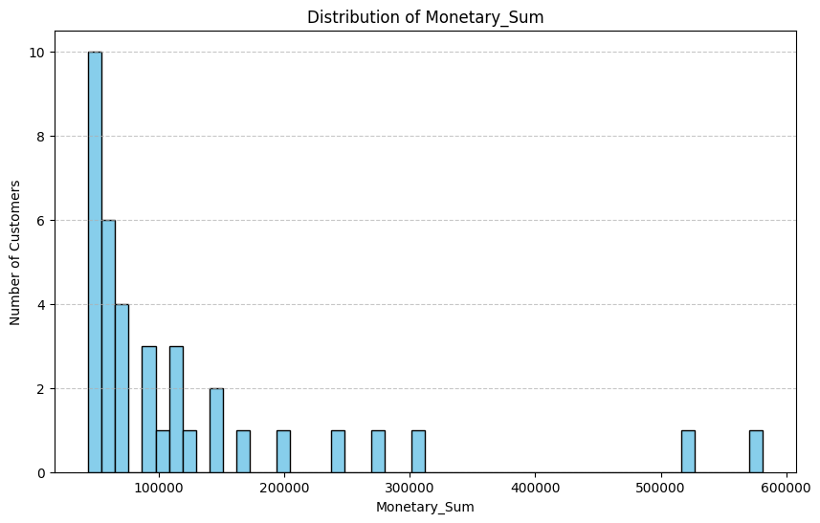
Distribution of Outliers

Slide 13
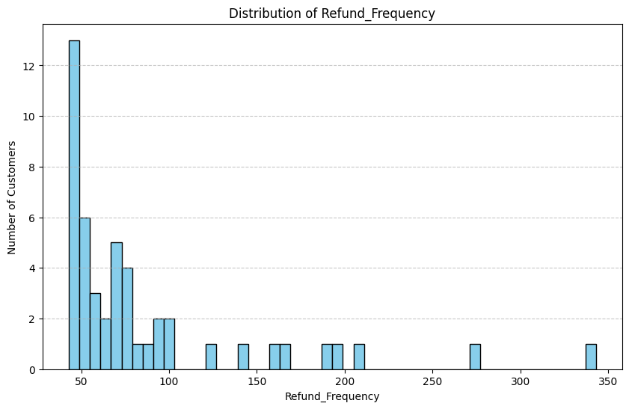
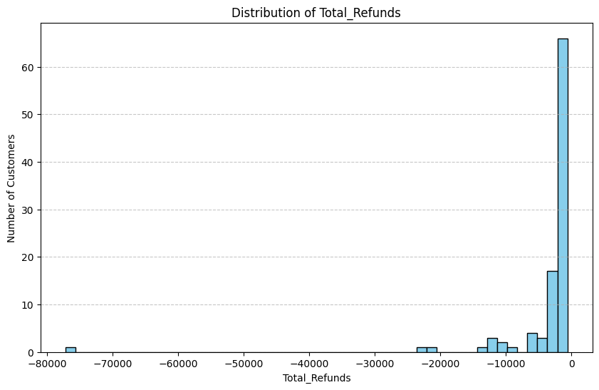
Distribution of Outliers

Slide 14
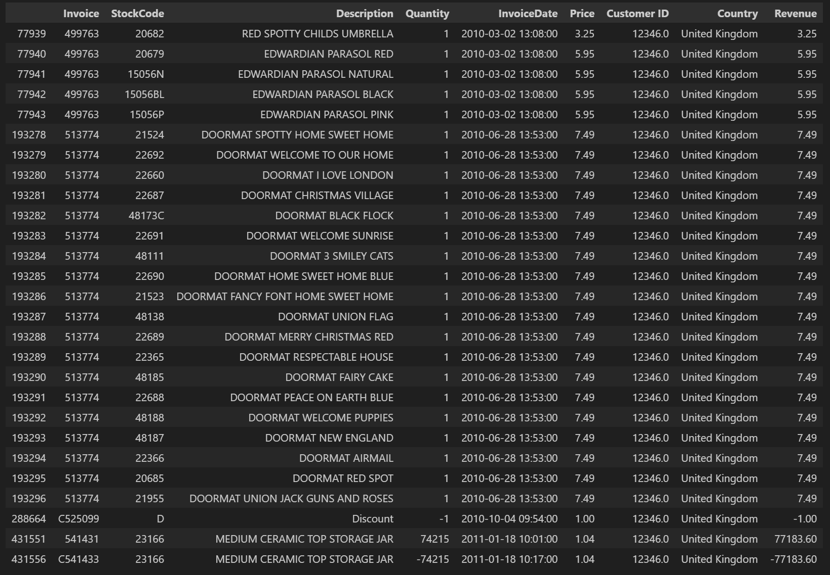
Removed Customer 12346

Slide 15
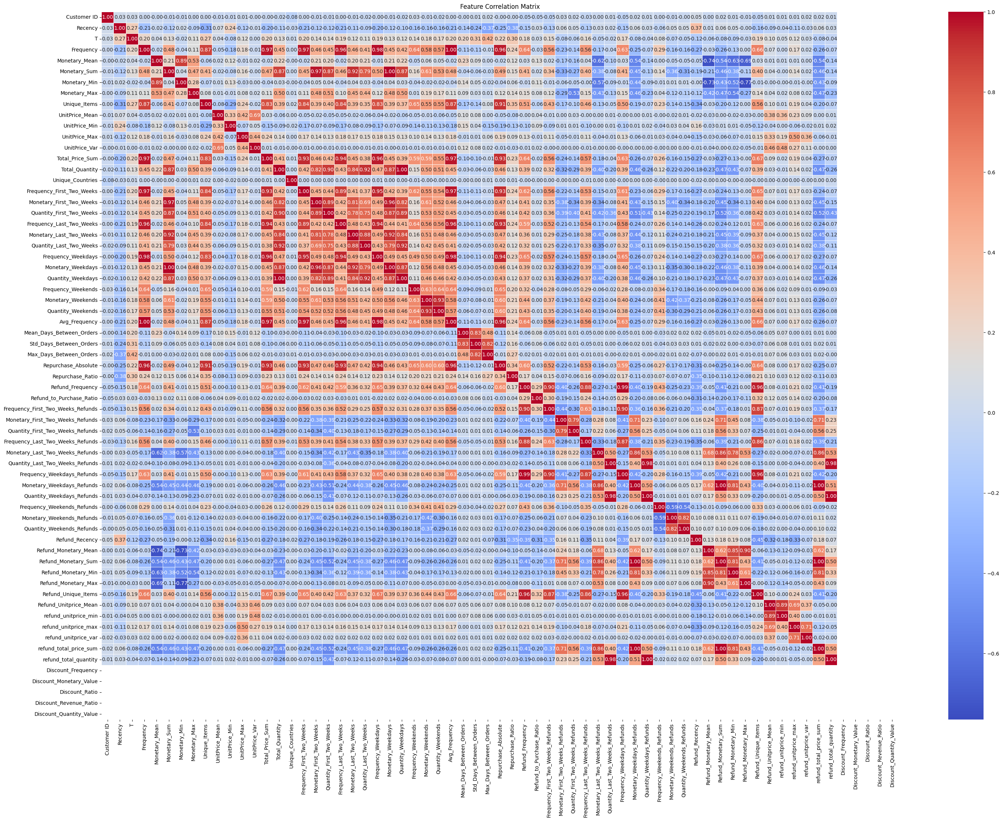
Correlation Matrix

Slide 16
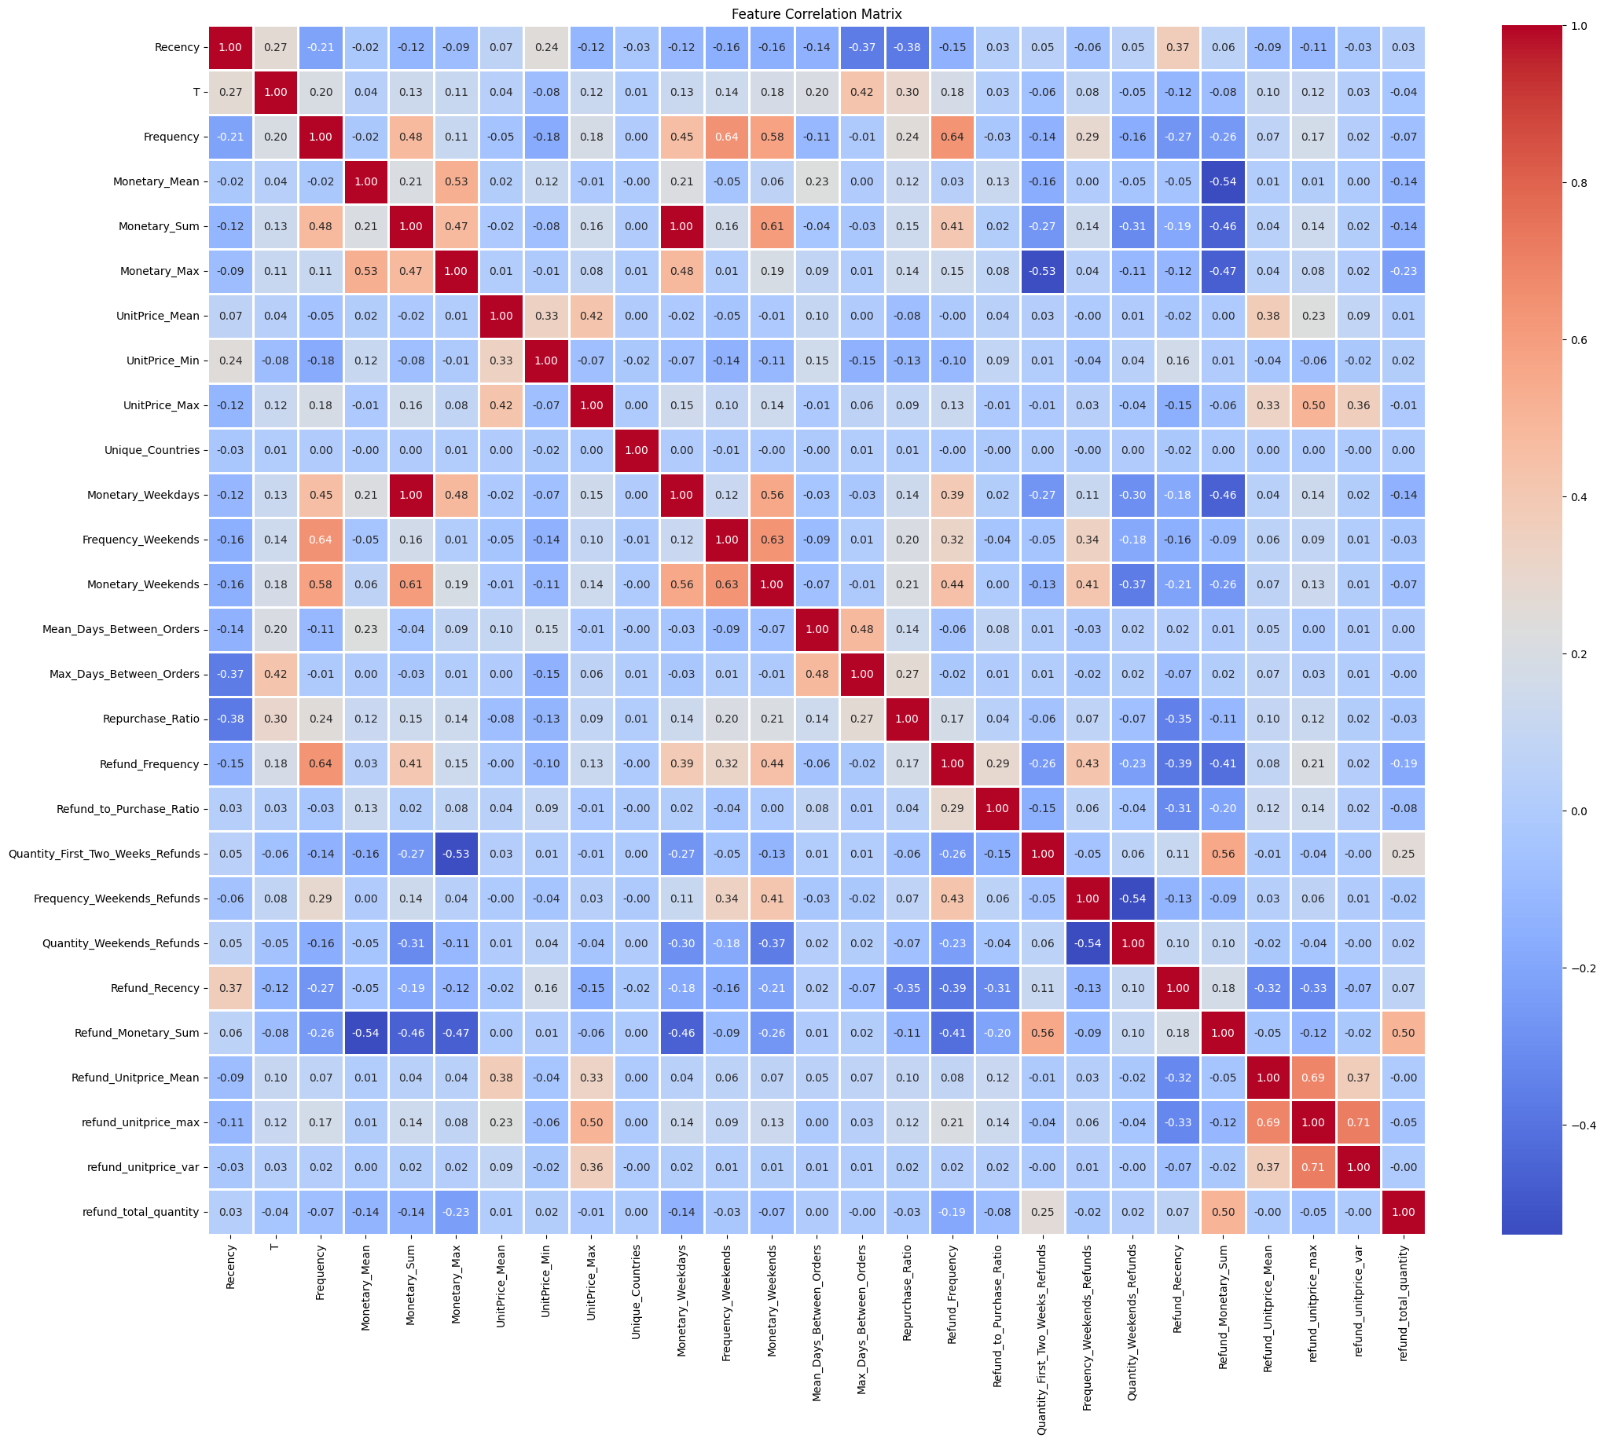
Cleaned
Correlation Matrix

Slide 17
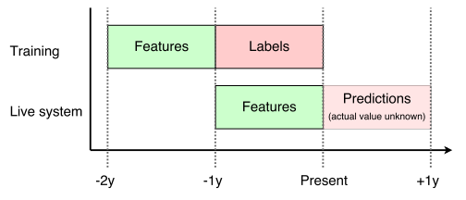
Training

Slide 18
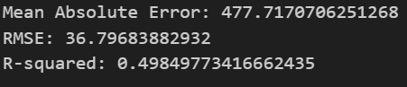
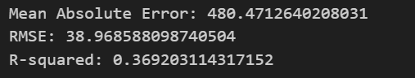
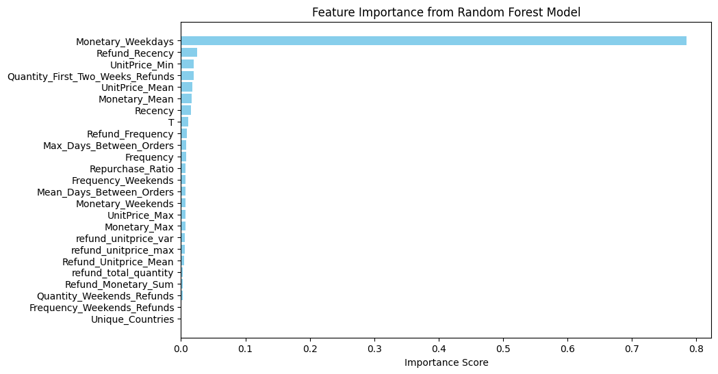
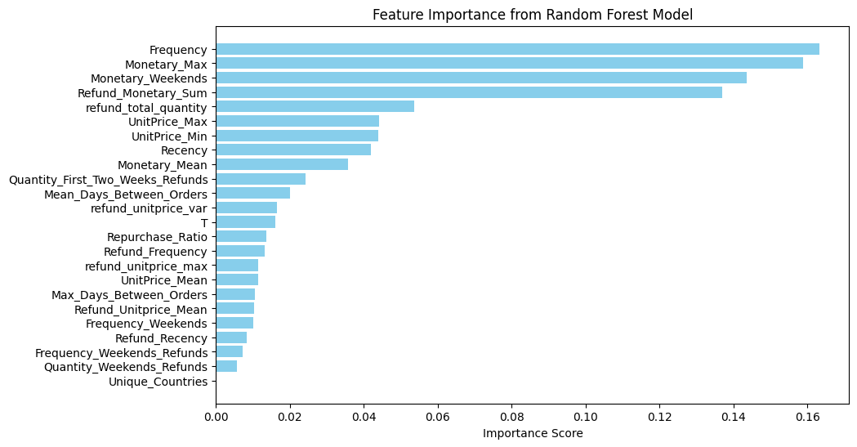
RandomForestRegressor without Monetary_Weekdays
RandomForestRegressor

Slide 19
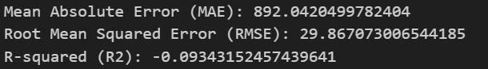
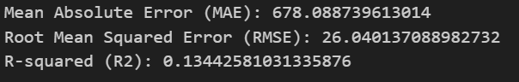
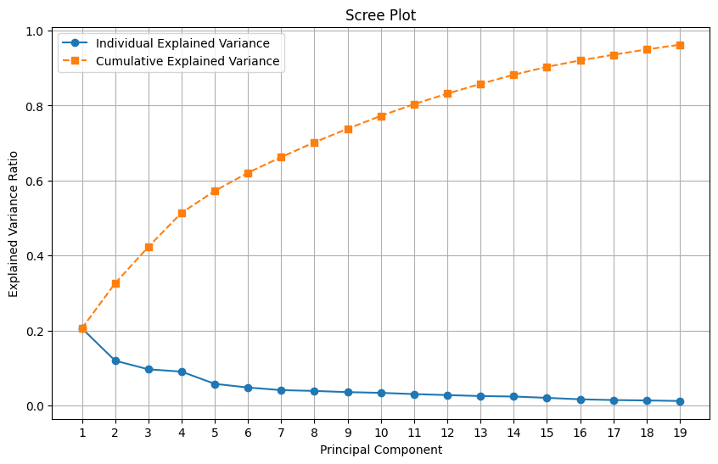
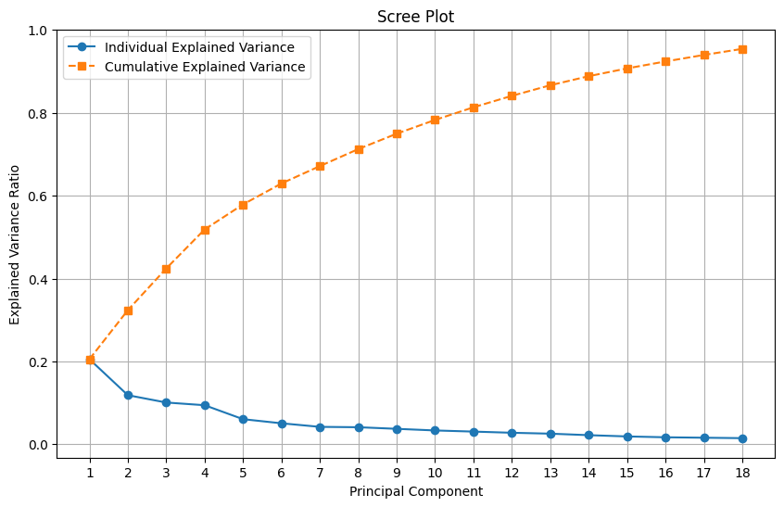
PCA
PCA without Monetary_Weekdays

Slide 20
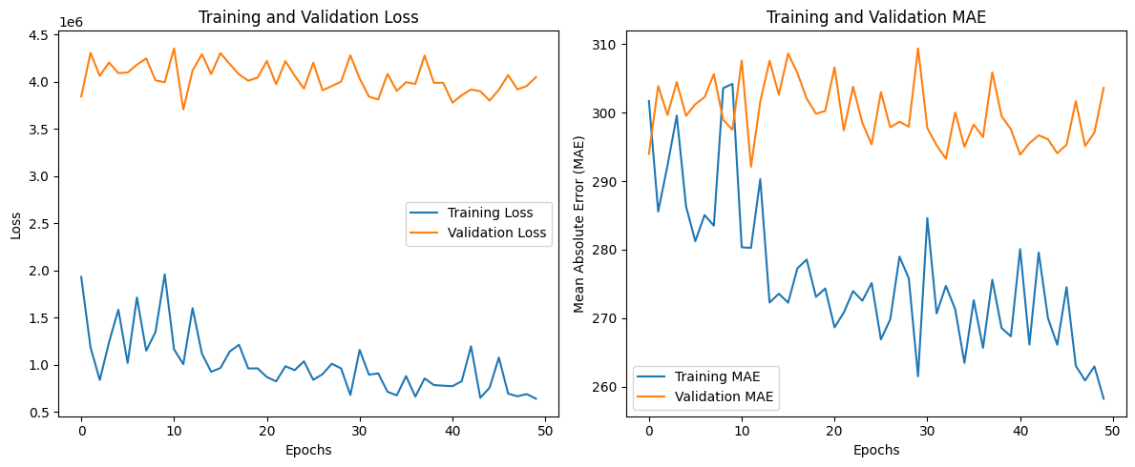
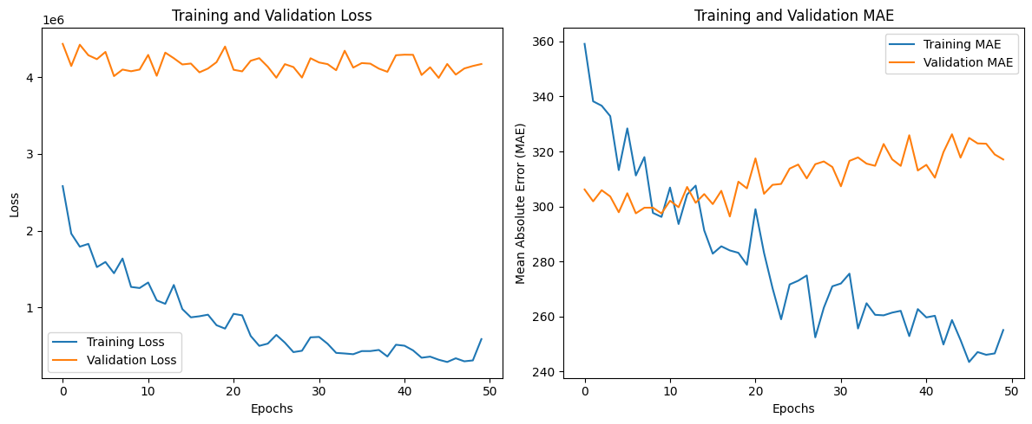
NeuralNetwork without Monetary_Weekdays
NeuralNetwork

Slide 21
Challenges
Identification of Description and StockCode variables
The complexities of relationship between different variables (Invoice, StockCode, Quantity, InvoiceDate)
Difficulties arose due to mismatched dataset shapes and insufficient learning during training.
Unusually high refunds and bulk purchases on single days skewed the dataset and impacted model predictions.
Persistently low/negative R-squared values despite scaling and feature optimization.
Strong feature skewness and multicollinearity hindered model accuracy.
Addressed these through scaling, advanced feature engineering, and dataset variations.
Correlation among refund-related and monetary features introduced multicollinearity.
Removal of redundant features improved dataset performance, but dominant features like Monetary Weekdays continued to overshadow others, limiting overall model accuracy.

Slide 22
Conclusion
Heavy Dataset Understanding
Not fit for model development
Helped in tackling a problem
Need to understand factors which make a good model

Slide 23
Capstone 2
Work with Dr. Shen
Test Project: Use 14 chemical physiochemical features (X) to predict chemical ecotoxicity HC50 (y) using data from Hou et al., 2020 using RandomForest, SVM, MLP, Lasso

Slide 24
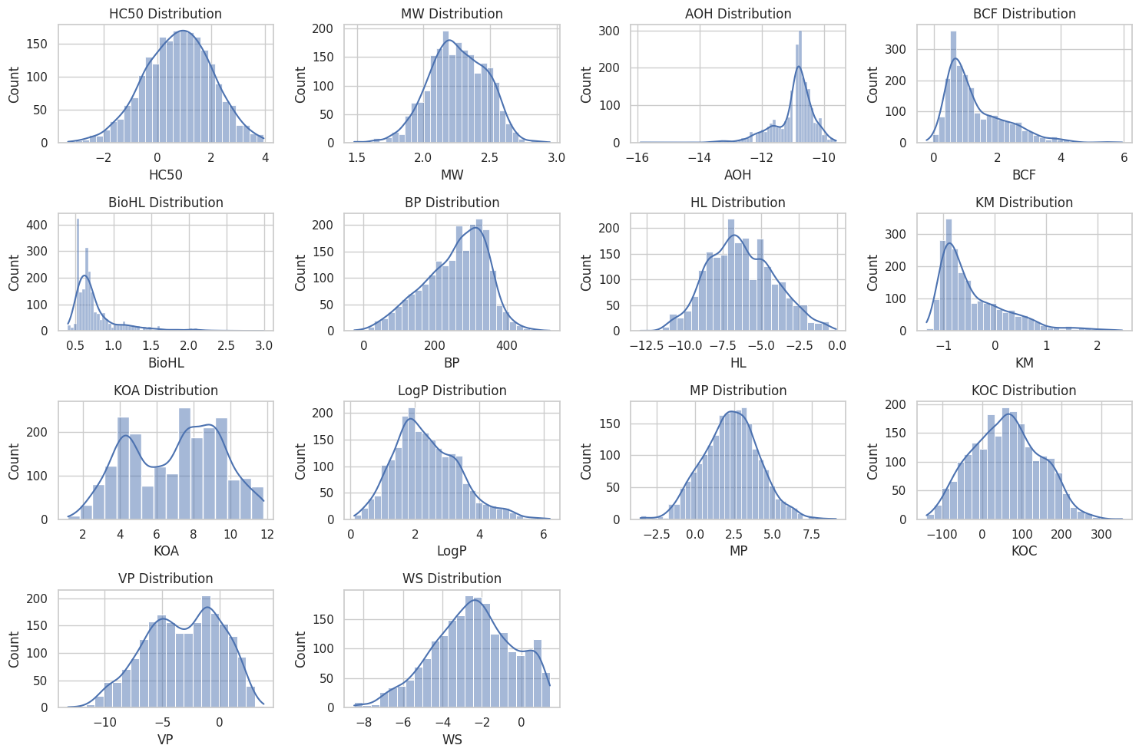
Data

Slide 25
Thank you

